Slide 1
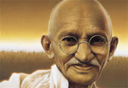
Father of the Nation
Mahatma Gandhi

Slide 2
About Mahatma Gandhi
Gandhiji was born on 2 October, 1869 in Porbandar, Gujrat .We celebrate this day as Gandhi Jayanti, a national holiday in India, and worldwide as the International Day of Non-Violence.
The title “Mahatma” was first given to him by Rabindranath Tagore. In India he is also called Bapu with love. And officially honoured in India as the Father of the Nation.

Slide 3
Gandhiji’s Stay in South Africa
He was educated in law at University College, London. In 1891, after having been admitted to the British bar, Gandhi returned to India and attempted to establish a law practice in Bombay, without much success. Two years later an Indian firm with interests in South Africa retained him as legal adviser in its office in Durban. Arriving in Durban, Gandhi found himself treated as a member of an inferior race. He was appalled at the widespread denial of civil liberties and political rights to Indian immigrants to South Africa. He threw himself into the struggle for elementary rights for Indians.
In 1914 the government of the Union of South Africa made important concessions to Gandhi's demands, including recognition of Indian marriages and abolition of the poll tax for them. His work in South Africa complete, he returned to India.

Slide 4
Back in India
In India he saw the unfair treatment of the common man by the British Empire and decided to get involved and work for the freedom of the country.
He organised protests by peasants, farmers, and urban labourers concerning excessive land-tax and discrimination.
He assumed leadership of the Indian National Congress in 1921.

Slide 5
Satyagraha- movement of non-violent resistance to Great Britain.
Indians in public office resigned, government agencies such as courts of law were boycotted, and Indian children were withdrawn from government schools. Throughout India, streets were blocked by squatting Indians who refused to rise even when beaten by police. Gandhi was arrested, but the British were soon forced to release him.

Slide 6
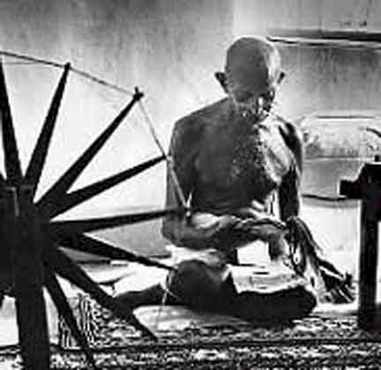
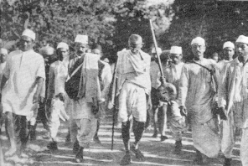
Mahatma Gandhi believed in Non-cooperation, Non-violence (Ahimsa)
Gandhi spinning Khadi (Cotton)
Salt Satyagraha “Dandi March’

Slide 7
Gandhiji’s Vision
Gandhiji led nationwide campaigns to ease poverty,
expand women's rights,
end untouchability,
and increase economic self-reliance.
Above all, he aimed to achieve Swaraj or the independence of India from foreign domination.
Gandhi famously led his followers in the Non-cooperation movement that protested the British-imposed salt tax with the 400 km (240 mi) Dandi Salt March in 1930.
Later, in 1942, he launched the Quit India civil disobedience movement demanding immediate independence for India.

Slide 8
Father of the Nation
Can we guess how he got this Designation?
He was the political and ideological leader of India during the Indian independence movement.
He gave direction to the freedom struggle
Came up with new ideas to push the momentum of the struggle forward

Slide 9
Ahimsa (Non-Violence)
In 1934 Gandhi formally resigned from politics, being replaced as leader of the Congress party by Jawaharlal Nehru. Gandhi traveled through India, teaching ahimsa and demanding eradication of "untouchability."
By 1944 the Indian struggle for independence was in its final stages, the British government having agreed to independence on condition that the two contending nationalist groups, the Muslim League and the Congress party, should resolve their differences.

Slide 10
India’s Independence
Gandhiji stood steadfastly against the partition of India but ultimately had to agree, in the hope that internal peace would be achieved after the Muslim demand for separation had been satisfied. India and Pakistan became separate states when the British granted India its independence in 1947.
During the riots that followed the partition of India, Gandhi pleaded with Hindus and Muslims to live together peacefully.

Slide 11
The End
There were lot of people not happy with the partition of India. Some blamed it on Gandhiji. One such fanatic person Nathuram Godse shot Gandhiji on Jan30th 1948 when he was on his way to his prayer meeting.
Gandhiji left this world but left behind a legacy that is still remembered and respected to this day.
The teachings of Gandhi came to inspire nonviolent movements elsewhere, notably in the U.S.A. under the civil rights leader Martin Luther King, Jr. and in South Africa under Nelson Mandela.

Slide 12
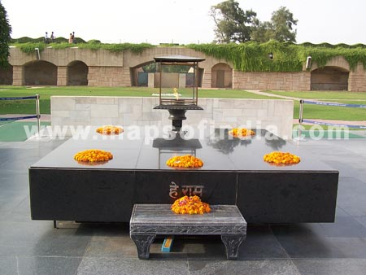
Gandhi’s memorial in Delhi - Rajghat

Slide 13
What children can learn from Gandhi
Truth or Satya
“The story of My experiments with Truth”
Non Violence or Ahimsa
“ An eye for an eye makes the whole world blind”
Faith
- Gandhi practiced Hinduism and believed all faiths to be equal
Simplicity
- Spun his own clothes and wore dhoti

